Slide 1
Query Optimization

Slide 2
INTRODUCTION TO QUERY PROCESSING (1)
Query optimization: the process of choosing a suitable execution strategy for processing a query.
Two internal representations of a query
  Query Tree
  Query Graph

Slide 3
A query expressed in a high level query language –SQL
  Scanned ,parsed and validated
  The scanner identifies the language tokens
  The parser checks the query syntax
  Checking all attributes and relation names are valid
An internal represent of the query is created usually as a tree data structure – query tree.

Slide 4
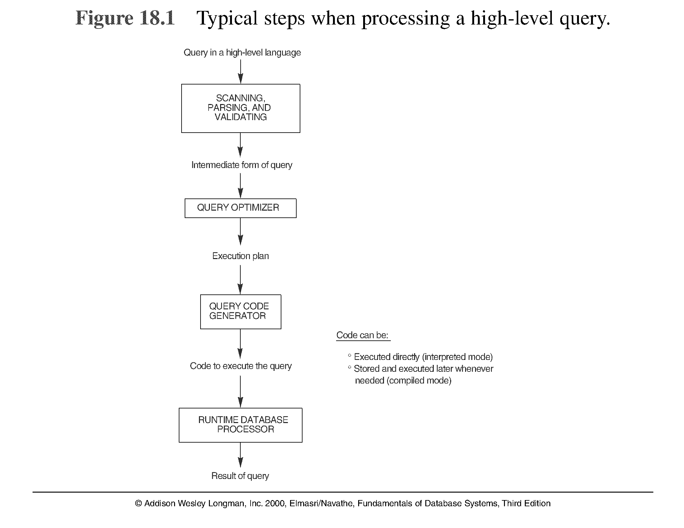

Slide 5
The query optimizer module has the task of producing an execution plan
The code generator generates the code to execute that plan.
The runtime db processor has the task of running the query code.
There are two main techniques for implementing query optimization
  Heuristic rules
  Cost estimation

Slide 6
TRANSLATING SQL QUERIES INTO RELATIONAL ALGEBRA (1)
Query block: the basic unit that can be translated into the algebraic operators and optimized.
A query block contains a single SELECT-FROM-WHERE expression, as well as GROUP BY and HAVING clause if these are part of the block.
Nested queries within a query are identified as separate query blocks.

Slide 7
TRANSLATING SQL QUERIES INTO RELATIONAL ALGEBRA (2)
SELECT LNAME, FNAME
FROM EMPLOYEE
WHERE SALARY > ( SELECT MAX (SALARY)
FROM EMPLOYEE
WHERE DNO = 5);
SELECT LNAME, FNAME
FROM EMPLOYEE
WHERE SALARY > C
SELECT MAX (SALARY)
FROM EMPLOYEE
WHERE DNO = 5
π_{LNAME, FNAME} (σ_{SALARY>C}(EMPLOYEE))
ℱ_{MAX SALARY} (σ_{DNO=5} (EMPLOYEE))

Slide 8
USING HEURISTICS IN QUERY OPTIMIZATION(1)
Process for heuristics optimization
The parser of a high-level query generates an initial internal representation;
Apply heuristics rules to optimize the internal representation.
A query execution plan is generated to execute groups of operations based on the access paths available on the files involved in the query.
The main heuristic is to apply first the operations that reduce the size of intermediate results.
E.g., Apply SELECT and PROJECT operations before applying the JOIN or other binary operations.

Slide 9
Query tree: a tree data structure that corresponds to a relational algebra expression. It represents the input relations of the query as leaf nodes of the tree, and represents the relational algebra operations as internal nodes.
Query graph: a graph data structure that corresponds to a relational calculus expression. It does not indicate an order on which operations to perform first. There is only a single graph corresponding to each query.

Slide 10
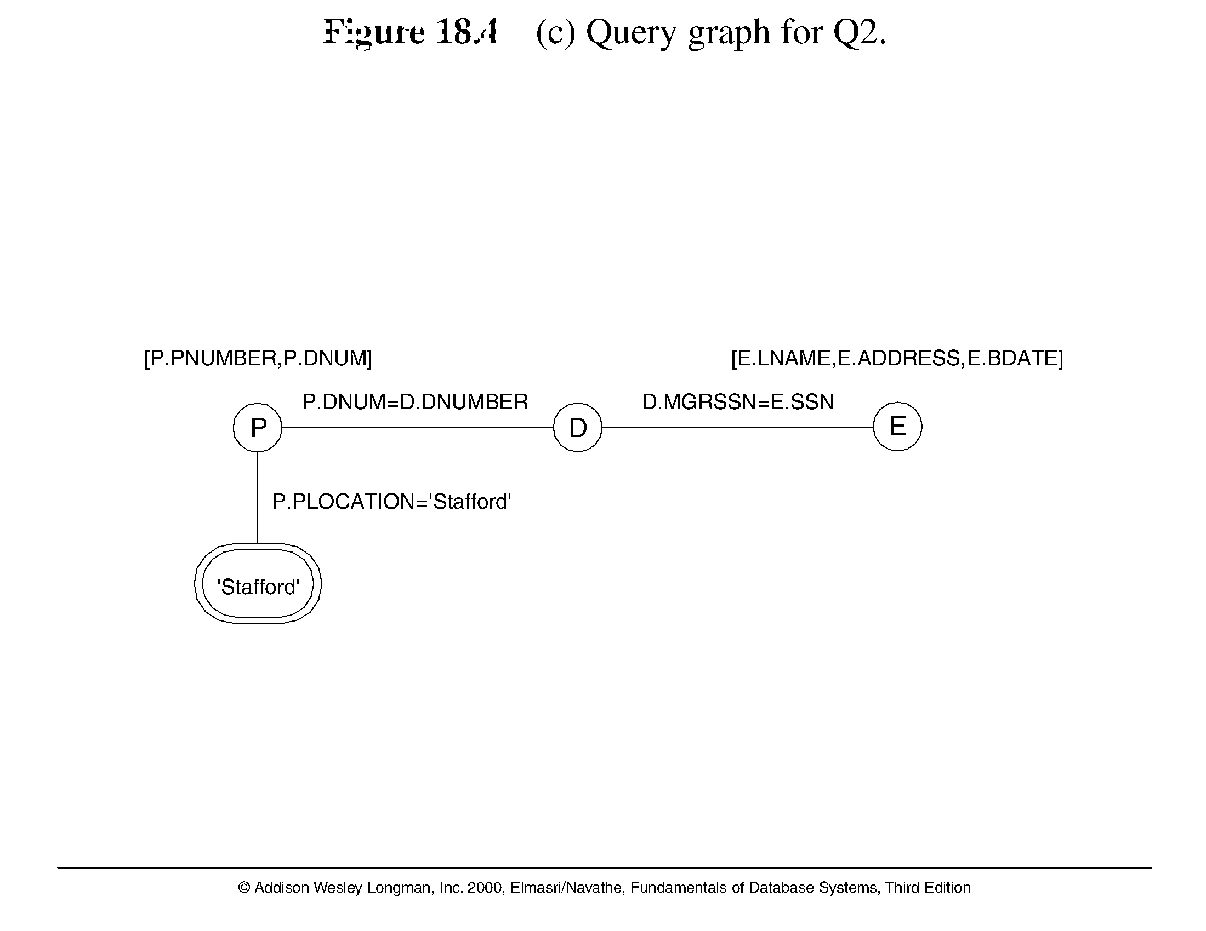

Slide 11
Heuristic Optimization of Query Trees:
The same query could correspond to many different relational algebra expressions — and hence many different query trees.
The task of heuristic optimization of query trees is to find a final query tree that is efficient to execute.
Example:
Q: SELECT LNAME
FROM EMPLOYEE, WORKS_ON, PROJECT
WHERE PNAME = ‘AQUARIUS’ AND PNMUBER=PNO
AND ESSN=SSN AND BDATE > ‘1957-12-31’;

Slide 12
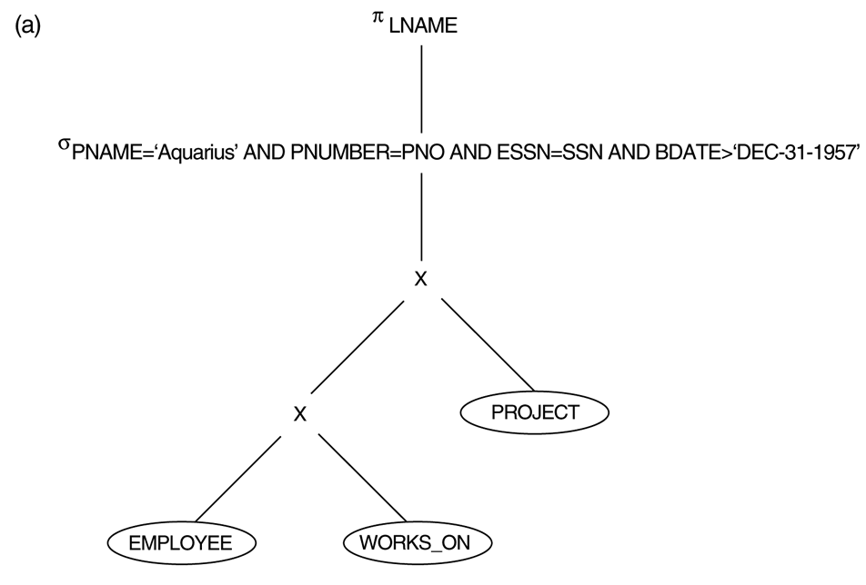
FIGURE 15.5
STEPS IN CONVERTING A QUERY TREE DURING HEURISTIC OPTIMIZATION. (A) INITIAL (CANONICAL) QUERY TREE FOR SQL QUERY Q.

Slide 13
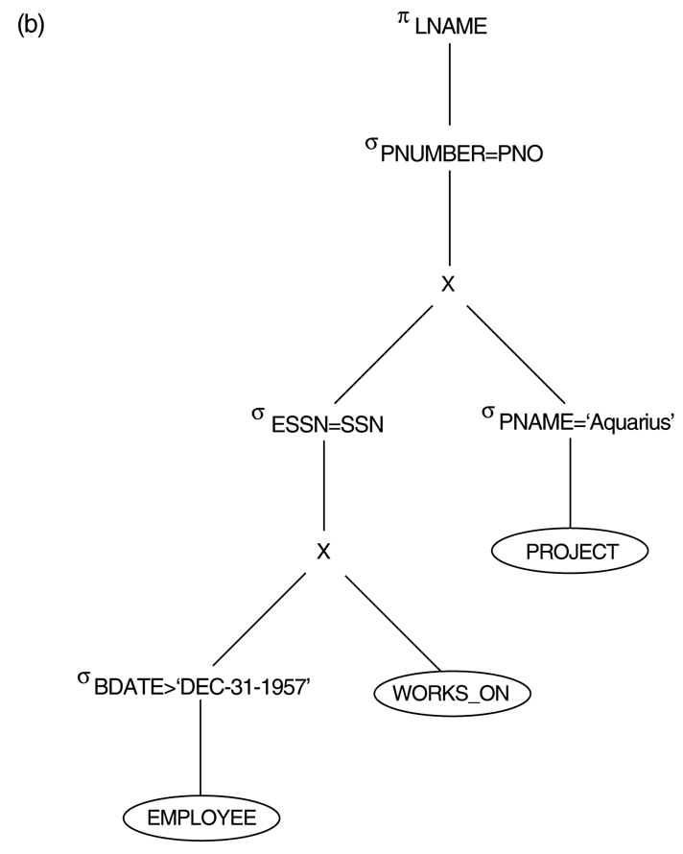
FIGURE 15.5 (CONTINUED)
STEPS IN CONVERTING A QUERY TREE DURING HEURISTIC OPTIMIZATION.
(B) MOVING SELECT OPERATIONS DOWN THE QUERY TREE.

Slide 14
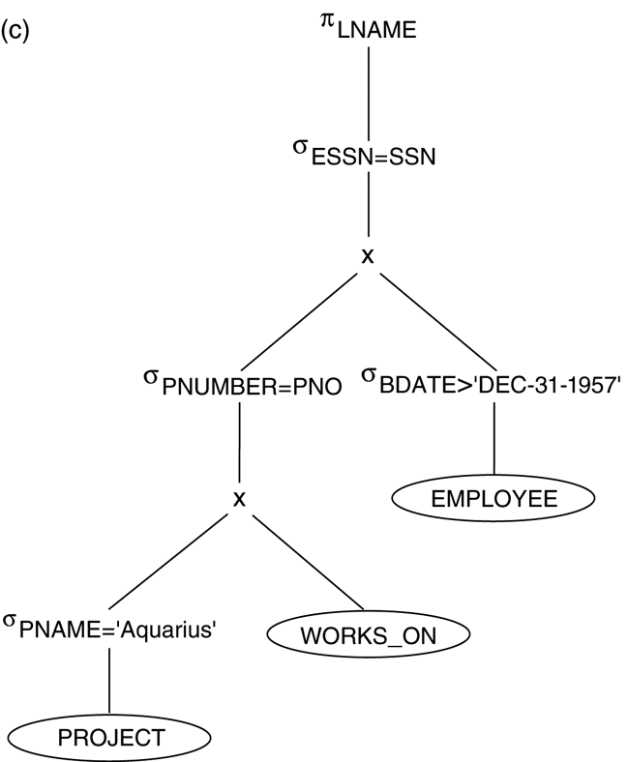
FIGURE 15.5 (CONTINUED)
STEPS IN CONVERTING A QUERY TREE DURING HEURISTIC OPTIMIZATION. (C) APPLYING THE MORE RESTRICTIVE SELECT OPERATION FIRST.

Slide 15
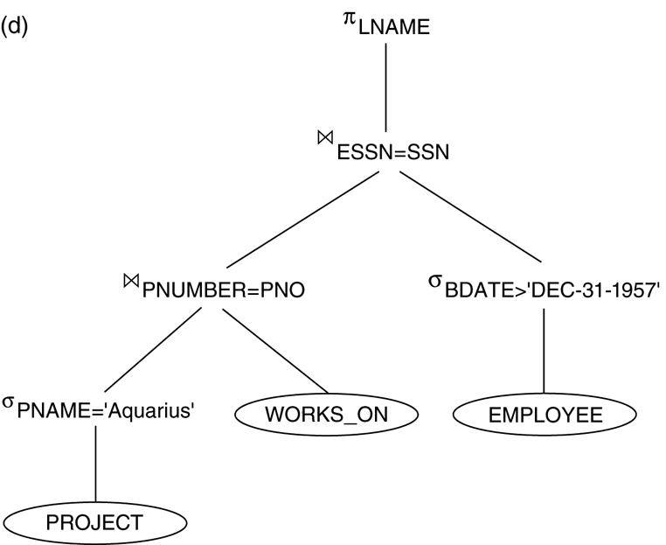
FIGURE 15.5 (CONTINUED)
STEPS IN CONVERTING A QUERY TREE DURING HEURISTIC OPTIMIZATION. (D) REPLACING CARTESIAN PRODUCT AND SELECT WITH JOIN OPERATIONS.

Slide 16
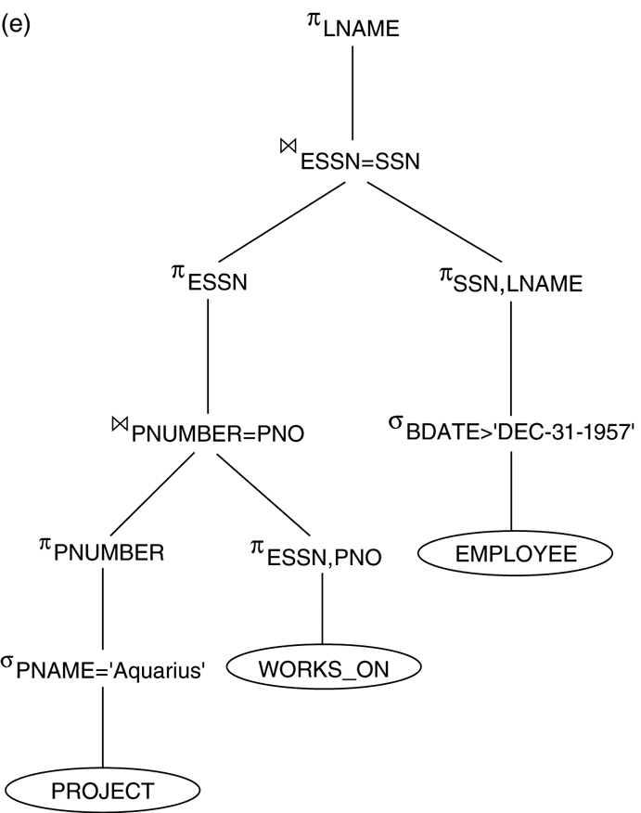
FIGURE 15.5 (CONTINUED)
STEPS IN CONVERTING A QUERY TREE DURING HEURISTIC OPTIMIZATION. (E) MOVING PROJECT OPEATIONS DOWN THE QUERY TREE.

Slide 17
1. Retrieve the name and address of all employees who work for the research department
SQL:
Select lname,address from employees e, department d where e.dno=d.no and dname=‘research’;
2. For every project located in stafford list the project number, the controlled department number and the dept mgr’s last name, address and birth date.
SQL:
Select pnumber, dnum,lname,address,bdate from (( project join department on dnum=dnumber) join employee on mgrssn=ssn) where plocation=‘stafford’;

Slide 18
Example:
For every project located in ‘Stafford’, retrieve the project number, the controlling department number and the department manager’s last name, address and birthdate.
Relation algebra:
πPNUMBER, DNUM, LNAME, ADDRESS, BDATE (((σ_{PLOCATION=‘STAFFORD’}(PROJECT))
_{DNUM=DNUMBER} (DEPARTMENT)) _{MGRSSN=SSN} (EMPLOYEE))
SQL query:
Q2: SELECT P.NUMBER,P.DNUM,E.LNAME, E.ADDRESS, E.BDATE
FROM PROJECT AS P,DEPARTMENT AS D, EMPLOYEE AS E
WHERE P.DNUM=D.DNUMBER AND D.MGRSSN=E.SSN AND
P.PLOCATION=‘STAFFORD’;

Slide 19
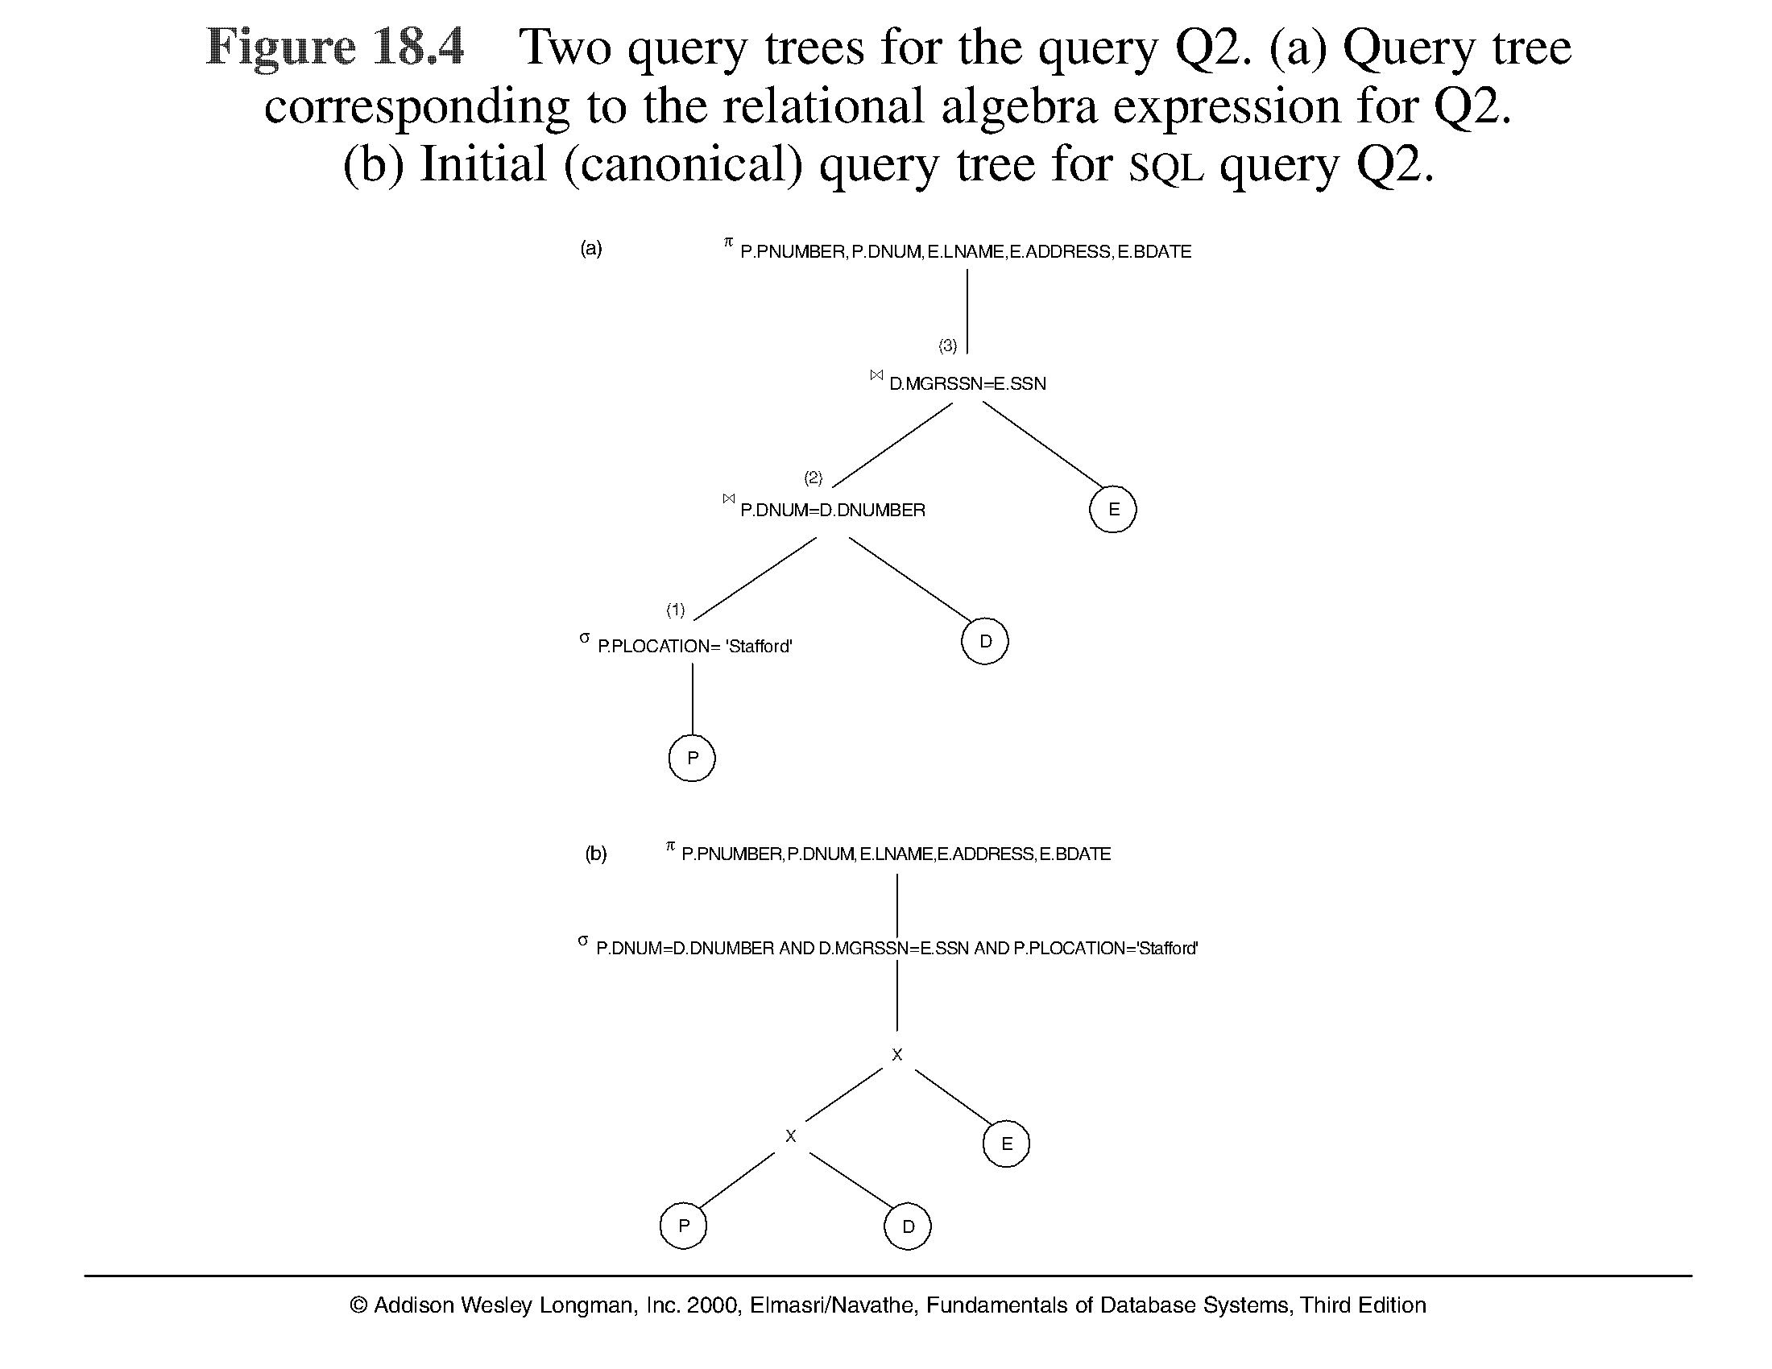

Slide 20
